Slide 1
Single Writer/Multiple Reader (SWMR)

Slide 2
SWMR Outline
Introduction
Current implementation
SWMR programming model
File locking under SWMR
SWMR demo

Slide 3
Introduction

Slide 4
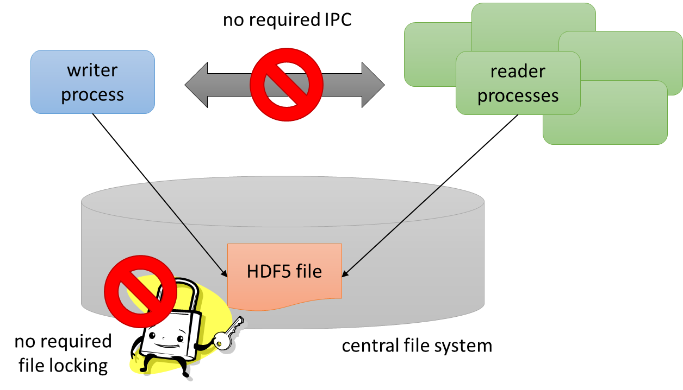
Basic Idea
Notes:
Many use cases call for a single writer process which writes data to a single HDF5 file, and multiple readers, which will consume the HDF5 data as it is written.
Ideally, we would like to support this scenario with no communication between the processes.
With no IPC/signals, there are clearly limits on how this can be used. Seeing arbitrary changes in the read files would be expensive. Readers will have to poll for expected changes.
- Changes in dataset sizes
- New groups created in a target group
- etc.

Slide 5
Concurrent read access to HDF5 files
New data elements…
Writer
Reader
HDF5 File
…which can be read by a reader…
with no IPC necessary.
… are added to a dataset in the file…
Notes:
No communications between the processes and no file locking are required. The processes can run on the same or on different platforms, as long as they share a common file system that is POSIX compliant.
The orderly operation of the metadata cache is crucial to SWMR functioning. A number of APIs have been developed to handle the requests from writer and reader processes and to give applications the control of the metadata cache they might need.

Slide 6
SWMR Approach
All communication between processes must be performed via the HDF5 file.
An HDF5 file under SWMR access must reside on the a system that complies with POSIX write() semantics.
Notes:
http://pubs.opengroup.org/onlinepubs/9699919799/
"After a write() to a regular file has successfully returned:
· Any successful read() from each byte position in the file that was modified by that write shall return the data specified by the write() for that position until such byte positions are again modified.
· Any subsequent successful write() to the same byte position in the file shall overwrite that file data.
"
And
"Writes can be serialized with respect to other reads and writes. If a read() of file data can be proven (by any means) to occur after a write() of the data, it must reflect thatwrite(), even if the calls are made by different processes. A similar requirement applies to multiple write operations to the same file position. This is needed to guarantee the propagation of data from write() calls to subsequent read() calls. This requirement is particularly significant for networked file systems, where some caching schemes violate these semantics.
Note that this is specified in terms of read() and write(). The XSI extensions readv() and writev() also obey these semantics. A new "high-performance" write analog that did not follow these serialization requirements would also be permitted by this wording. This volume of POSIX.1-2008 is also silent about any effects of application-level caching (such as that done by stdio).
"
Also
"This volume of POSIX.1-2008 does not specify behavior of concurrent writes to a file from multiple processes. Applications should use some form of concurrency control."

Slide 7

The Challenge
Data
The basic engineering challenge is to ensure that the readers always see a coherent (though possibly not up to date) HDF5 file.
Writer
Reader
Reader
Reader
HDF5 File

Slide 8
HDF5 Writer State
Writer Process
Metadata
Cache
Physical File
Writer
State

Slide 9

HDF5 Reader State
Writer
State
Cache
File
Reader Process
Reader
State
A reader process can only see the state contained in the physical file.

Slide 10
HDF5 State Badness
So how do we address* this?
Reader Process
:’(
* pun very much intended

Slide 11
Preventing File Address Badness
Most importantly, internal file pointers in the physical file must never point to invalid (unflushed, etc.) file addresses.
1
(2)
2
metadata
item 1
metadata
item 2
address of metadata item 2
Physical File

Slide 12

Preventing File Address Badness
Most importantly, internal file pointers in the physical file must never point to invalid (unflushed, etc.) file addresses.
1
(2)
BAD
Physical File

Slide 13
Metadata Flush Dependencies
Suppose we have a metadata item (parent) which refers to another metadata item (child) in the file.
metadata
item 1
(parent)
metadata
item 2
(child)
1
(2)
2
address of metadata item 2

Slide 14
Metadata Flush Dependencies
If we add a new child item to the file and update the reference in the parent, we have to be careful about the order in which the metadata is flushed out of the cache.
1
old child
(3)
2
parent
3
new child
address of new child

Slide 15
Metadata Flush Dependencies
If the parent is flushed before the new child, the reader may attempt to load the unflushed child from the disk, creating an invalid state.
1
1
(3)
(3)
BAD
3
garbage?
Writer
HDF5 File
Reader
15

Slide 16
Metadata Flush Dependencies
If the new child metadata item is flushed before the updated parent item, the reader will not be fully up to date, but will still be consistent.
OK
1
1
(2)
(3)
2
3
3
Writer
HDF5 File
Reader
16

Slide 17
Metadata Flush Dependencies
Solution:
HDF5 implements flush dependencies in the internal data structures to ensure that metadata cache flush operations occur in the proper order.
OK
1
1
(2)
(3)
2
3
3
Writer
HDF5 File
Reader
17

Slide 18
Data access to file being written
Implemented for raw data “append only” scenario
No creation or deletion of the datasets, groups, and attributes is allowed at this time
Works on GPFS, Lustre, Linux Ext3, Ext4, FreeBSD USF2, OS X HDFS+
Does not work on NFS or Samba
Documentation http://www.hdfgroup.org/HDF5/docNewFeatures/
Source ftp://ftp.hdfgroup.uiuc.edu/pub/outgoing/SWMR/
Testers are needed!

Slide 19
SWMR Programming model

Slide 20
Setting SWMR writer
Precondition
Create a file with the latest file format; close the file.
Writer
Call H5Fopen using the H5F_ACC_SWMR_WRITE flag.
Start writing datasets.
Periodically flush data.
or
Writer
Call H5Fcreate using the latest file format flag.
Create groups, datasets; add attributes and close attributes.
Call H5Fstart_swmr_write to start SWMR access to the file.
Periodically flush data.

Slide 21
Setting SWMR reader
Reader
Call H5Fopen using the H5F_ACC_SWMR_READ flag.
Poll, checking the size of the dataset to see if there is new data available for reading.
Read new data, if any.
Side affect of SWMR access
Fault tolerance

Slide 22
Example of SWMR writer
//Create the file using the latest file format property as shown
fapl = H5Pcreate(H5P_FILE_ACCESS);
H5Pset_libver_bounds(fapl, H5F_LIBVER_LATEST, H5F_LIBVER_LATEST);
fid = H5Fcreate(filename, H5F_ACC_TRUNC, H5P_DEFAULT, fapl);
// Create file objects such as datasets and groups.
// Close attributes and named datatypes objects. Groups and
// datasets may remain open before starting SWMR access to
// them.
// Start SWMR access the file
status = H5Fstart_swmr_write(fid);
// Reopen datasets and start writing
H5Dwrite(dset_id, …);
H5Dflush(dset_id); // periodically to flush the data for a particular dataset.

Slide 23
Example of SWMR reader
// Open the file using SWMR read flag
fid = H5Fopen(filename, H5F_ACC_RDONLY | H5F_ACC_SWMR_READ, H5P_DEFAULT);
// Open the dataset, poll dimensions, read new data and refresh; repeat.
dset_id = H5Dopen(…);
space_id = H5Dget_space(…);
while (…) {
H5Dread(…); // read if any new data arrives
H5Drefresh;
H5Dget_space(…);
}

Slide 24
Controlling SWmr access

Slide 25
APIs for controlling SWMR writing and reading
Application can control when data is visible using data flushing and refreshing:
H5Dflush – flushes all buffers associated with a dataset
H5Drefresh – clear the buffers and reload from the disk
Application can control MDC flushing of an object:
H5Odisable_mdc_flushes
H5Oenable_mdc_flushes

Slide 26
APIs for controlling SWMR writing
H5DOappend to append data to a dataset
Extends dataspace and writes new elements
APIs to control flush behavior when append reaches a specified boundary
H5Pget(set)_append_flush() for a dataset access property list
Calls the specified callback function
Flushes the dataset
H5Pget(set)_object_flush_cb() for a file access property list
Sets a callback function to invoke when a object flush occurs in the files

Slide 27
H5watch and other tools

Slide 28
h5watch
Allows to monitor the growth of a dataset
Prints new elements whenever the application extends the size and adds data
For compound datasets prints data for specified fields
Example:
h5watch --help
h5watch --polling=5 ./f.h5/g/ds

Slide 29
Other command-line tools
We plan to make h5dump and h5ls SWMR enabled
The rest of the tools will exit gracefully reporting that the file is under construction
h5diff, h5repack, h5copy, h5jam, etc.

Slide 30
File locking under swmr

Slide 31
Concurrent Access to HDF5 file
The HDF5 library will employ two means to regulate access to HDF5 files:
File locking API calls to apply or remove an advisory lock on an open file.
Setting a flag in the file’s superblock to mark the file as open for writing.

Slide 32
Concurrent Access to HDF5 file
File locking API calls to apply or remove an advisory lock on an open file.
Files will be locked during the H5Fopen() or H5Fcreate() call.
Locks can be shared (read) or exclusive (write).
Locks will lock the entire file, not regions in the file.
When non-blocking lock calls are available, locks will not block.
Locks will be released automatically when the file closes. Alternatively, the user can unlock the file using the system's unlock call, however care will have to be taken to match the HDF5 library's file locking scheme.
Notes:
Note that these will also be used for non-SWMR access as a way to prevent inappropriate file access (e.g., two writers).

Slide 33
Concurrent Access to HDF5 file
Setting a flag in the file’s superblock to mark the file as open for writing.
The library will mark the file when opened for writing based on file open access flags. This will happen for both SWMR and non-SWMR reading. This marking ensures file consistency for concurrent accesses.
The library will clear the flag when the file closes.
Only understandable by HDF5 1.10.x (file format change)

Slide 34
Writer Actions
When a writer process creates/opens a file without SWMR:
Place an exclusive lock on the file—the file will remain locked until it closes.
Ensure the file's superblock is not already marked for writing or SWMR writing mode.
Mark the file's superblock for writing mode.
When a writer process creates/opens a file with SWMR write access:
Place an exclusive lock on the file.
Ensure the file's superblock is not already marked for writing or SWMR writing mode.
Mark the file for writing and SWMR writing mode.
Release the lock before returning from H5Fopen/H5Fcreate.

Slide 35
Reader Actions
When a reader process opens a file without SWMR:
Place a shared lock on the file.
Ensure the file is not already marked for writing or SWMR writing mode.
When a reader process opens a file with SWMR read:
Place a shared lock on the file.
Ensure the file is marked in writing and SWMR writing mode

Slide 36
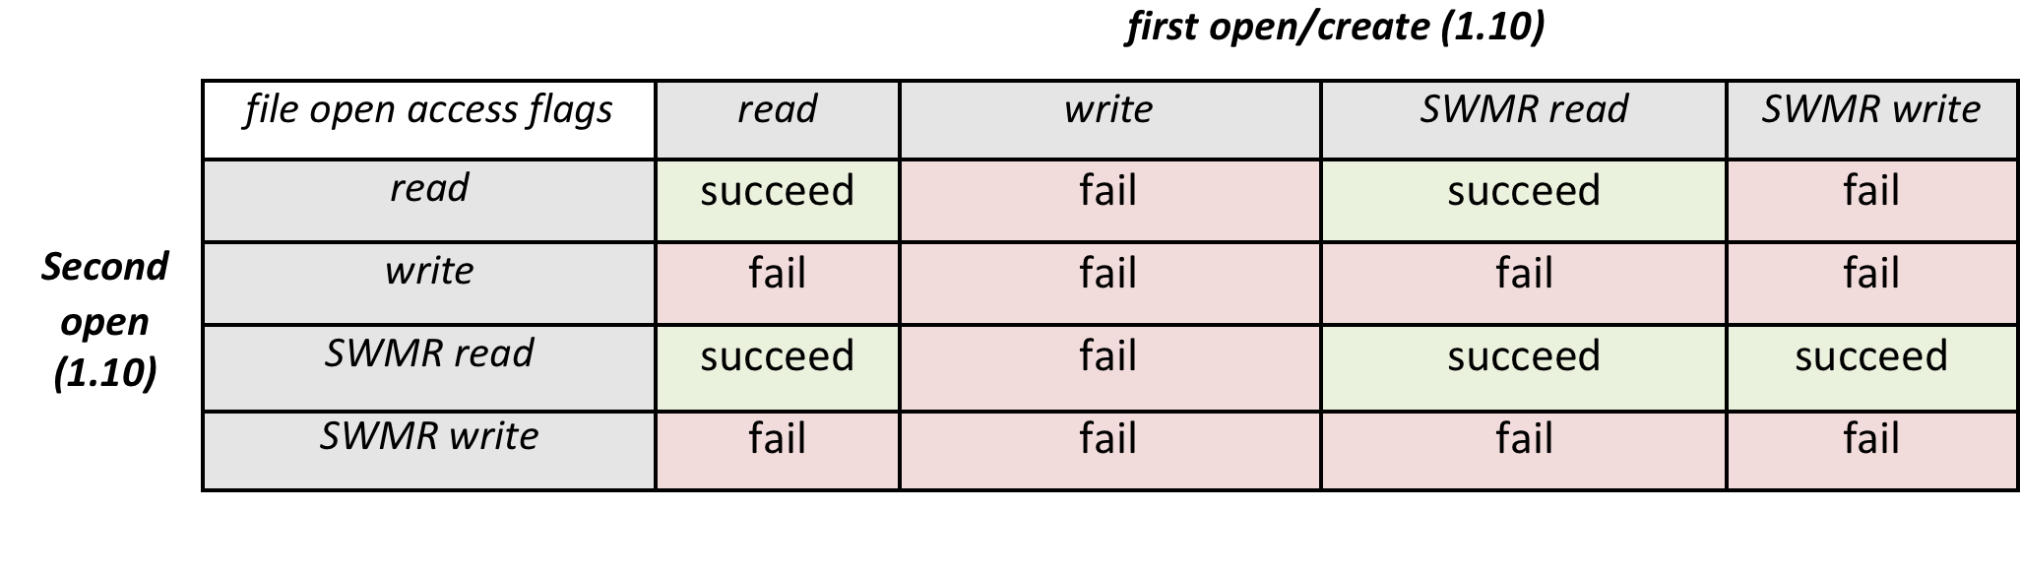
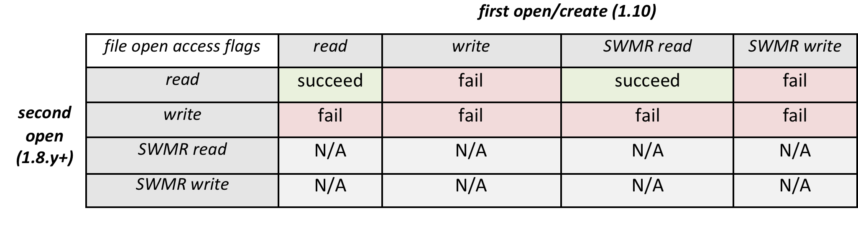
SWMR Compatibility Matrix

Slide 37
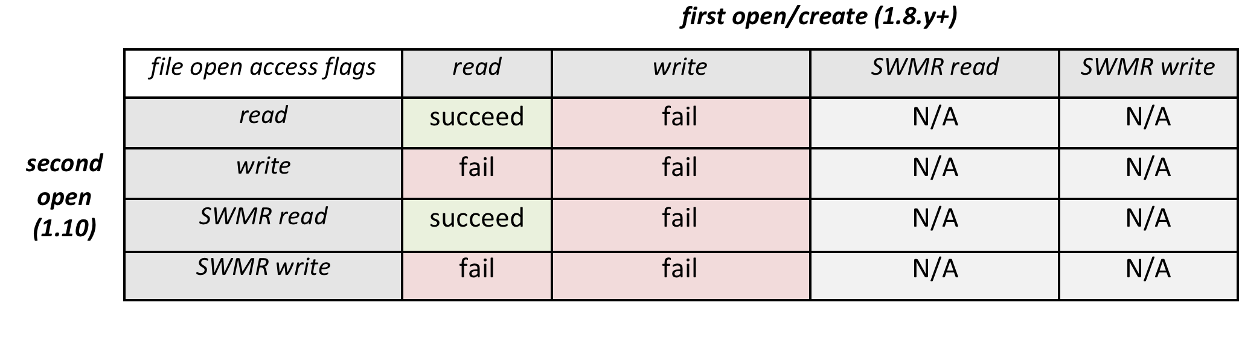
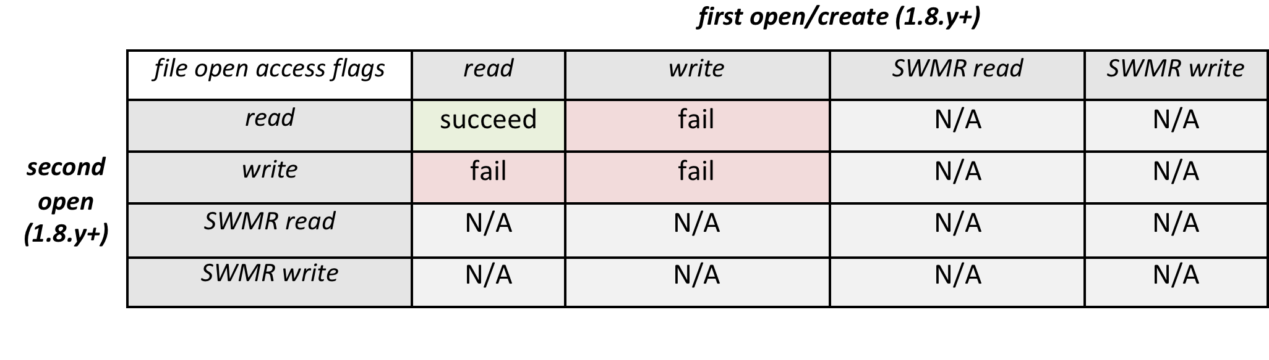
SWMR Compatibility Matrix

Slide 38
Is an HDF5 file under SWMR access?
We will provide APIs to get information on a file access under SWMR:
Does H5Fopen fail because of the existing file lock?
H5LTcheck_lock_error (under implementation)
When H5Fopen succeeds, is a file accessed by a SWMR writer?
TBD

Slide 39
Demo
HDF5 provides some tests you may try; see SWMR UG, section 6.
We will be using test/use_append_chunk to write 3D dataset by planes (chunks 1x2056x256).
Use h5watch to see data coming
Interrupt use_append_chunk
Use h5clear tool to clear the flags
Use h5dump to see data
chunksize
chunksize
chunksize
Notes:
hdf5-swmr/test/use_append_chunk -f test-swmr.h5 -z 2056 -l w &
hdf5-swmr/hdf5/bin/h5watch test-swmr.h5/use_append_chunk
Kill both h5watch and use_append_chunk
Try h5dump - fails
hdf5-swmr/hdf5/bin/clear test-swmr.h5
Get how much data was written
hdf5-swmr/hdf5/bin/h5dump -Hp test-swmr.h5
Read first 8 elements of each first row of each plane;
hdf5-swmr/hdf5/bin/h5dump --dataset="/use_append_chunk[1000,0,0 ;1,2056,2056;250,1,1;1,1,8]" test-swmr.h5

Slide 40
Thank You!
Questions?

